Slide 1
Training Model
(What’s under the hood)
길민호

Slide 2
01
Training Model

Slide 3
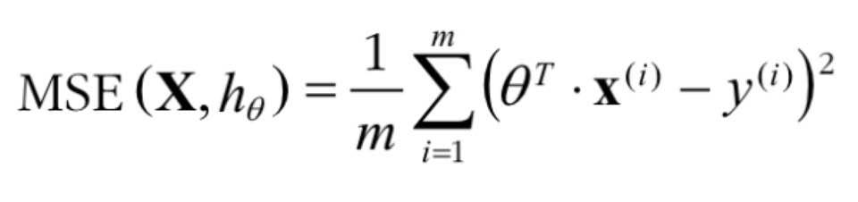
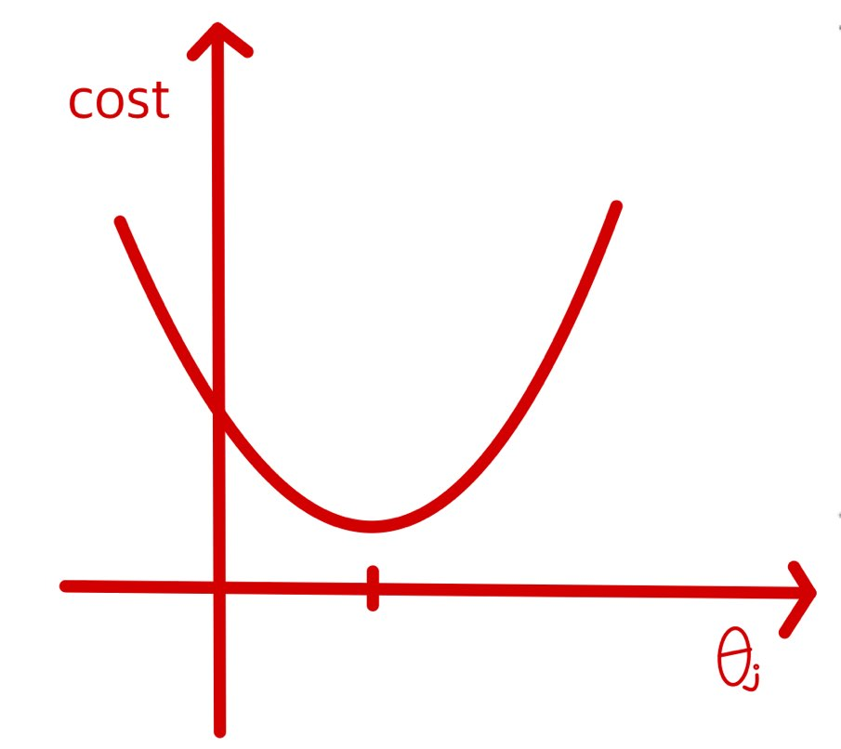
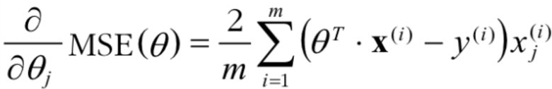
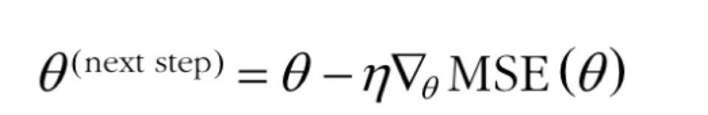
01.
Training Model
Gradient descent
<MSE cost function for a Linear Regression model>
기울기 양수
기울기 음수
<Partial derivatives of the cost function>
<θj against cost Graph>
<Gradient Descent Step>

Slide 4
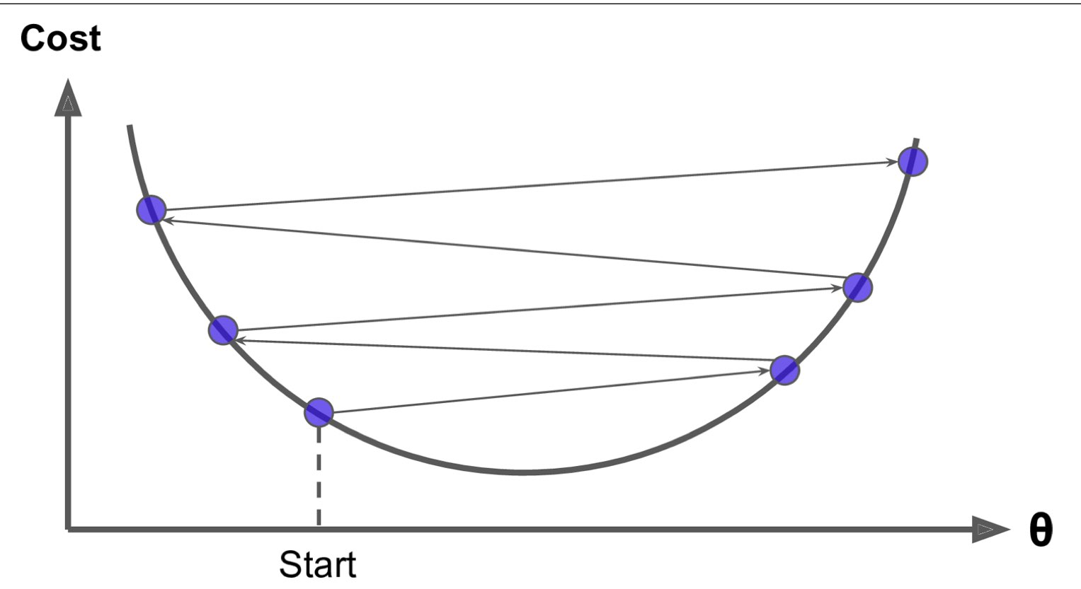
01.
Training Model
Gradient descent
<Gradient Descent Step>
<Learning Rate too large>

Slide 5
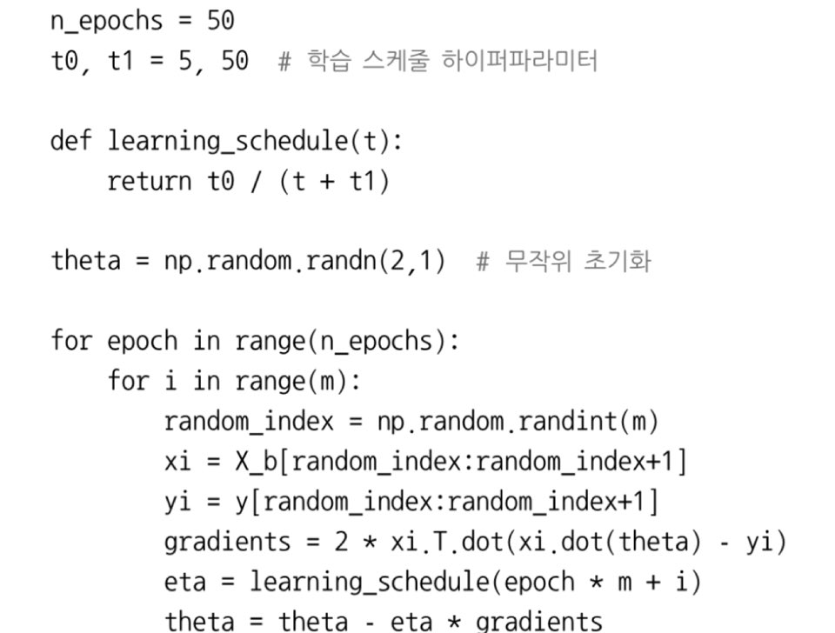
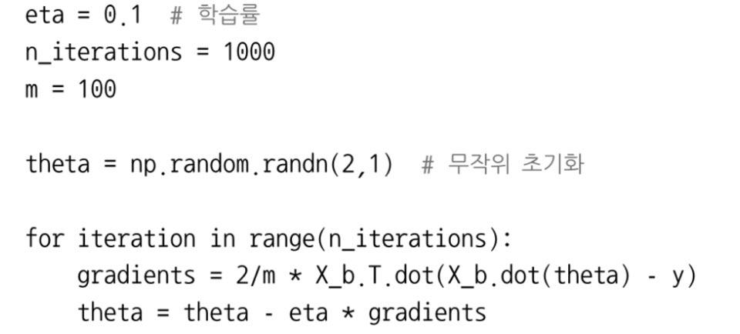
01.
Training Model
Stochastic Gradient Descent
<Batch Gradient Descent Code>
<Stochastic Gradient Descent Code>

Slide 6
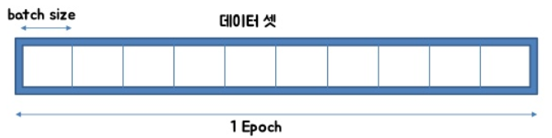
01.
Training Model
Stochastic Gradient Descent
Batch size : Number of data to learn at a time
Epoch : Number of times the entire data is repeatedly learned
Iteration : The number of times to learn a batch in one epoch.

Slide 7

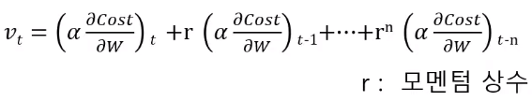
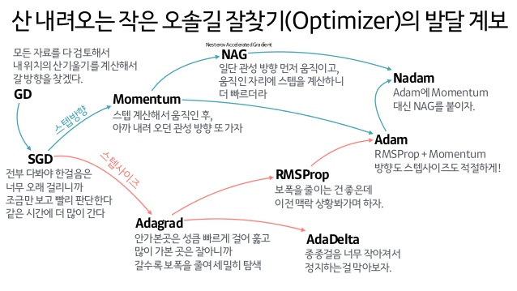
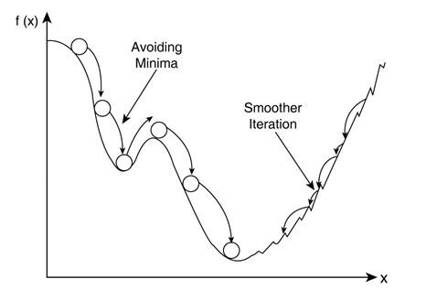
01.
Training Model
Momentum
<Momemtum>

Slide 8
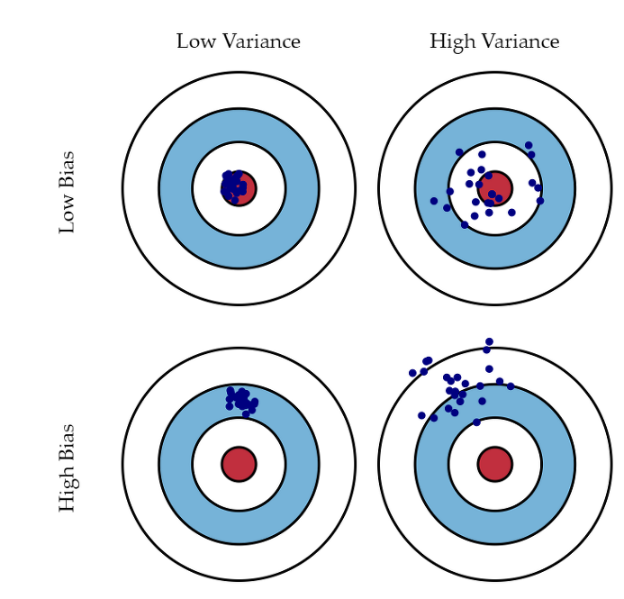
01.
Training Model
What is Bias and Variance?
<Graphical illustration of bias and variance>

Slide 9




01.
Training Model
What is the difference between Multiple Regression and Polynomial Regression?
<Multiple Regression>
<Polynomial Regression>

Slide 10
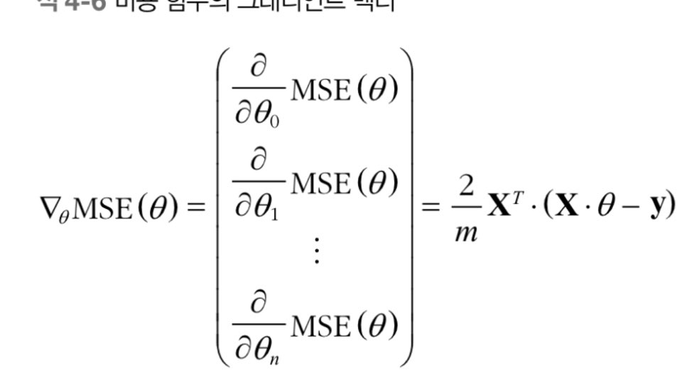
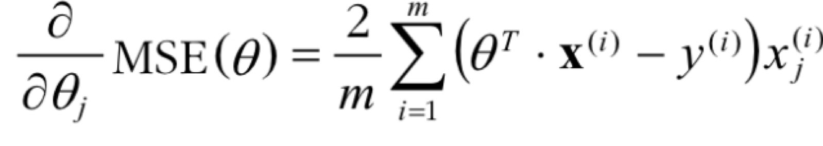
01.
Question1
<MSE Partial derivative>
<Gradient Vector>

Slide 11
01.
Additional Information
Tab nine
(https://github.com/wenmin-wu/jupyter-tabnine)
<Tabnine>

Slide 12


Slide 13
Thank you
나눔스퀘어

